Slide 1
Employee Data Analysis using Excel
STUDENT NAME : SREEVARAN G
REGISTER NO : 2213211036049
DEPARTMENT : COMMERCE
COLLEGE : PRESIDENCY COLLEGE

Slide 2
PROJECT TITLE
Employee Performance Analysis using Excel

Slide 3


AGENDA
Problem Statement
Project Overview
End Users
Our Solution and Proposition
Dataset Description
Modelling Approach
Results and Discussion
Conclusion
3/21/2024 Annual Review

Slide 4

PROBLEM STATEMENT
The organization is experiencing varying levels of employee performance across different departments, which may be impacting overall productivity and business outcomes.
There is a need to identify key factors influencing these performance discrepancies, evaluate the effectiveness of current performance management practices, and develop strategies to enhance employee performance uniformly across the organization
These are the problems in performance, i.e. Set Clear Goals ,Invest in Training ,Give Feedback , Link Rewards ,Promote Advancement

Slide 5

PROJECT OVERVIEW
The employee performance project aims to assess and enhance the effectiveness and efficiency of staff within an organization. This initiative involves evaluating individual and team performance through a combination of metrics, feedback, and performance reviews.
The project will implement performance management systems to set clear objectives, track progress, and identify areas for improvement. Additionally, it will provide tailored training and development opportunities to address skill gaps and foster professional growth.
The ultimate goal is to boost overall productivity, align employee goals with organizational objectives, and create a more engaged and motivated workforce.

Slide 6

WHO ARE THE END USERS?
HR Managers | For decisions on promotions and training.
Team Managers | To address performance issues and set goals.
Senior Management | For strategic planning and development.
Employees | To receive feedback and development recommendations.
Training Specialists | They use performance data to design targeted training programs.

Slide 7

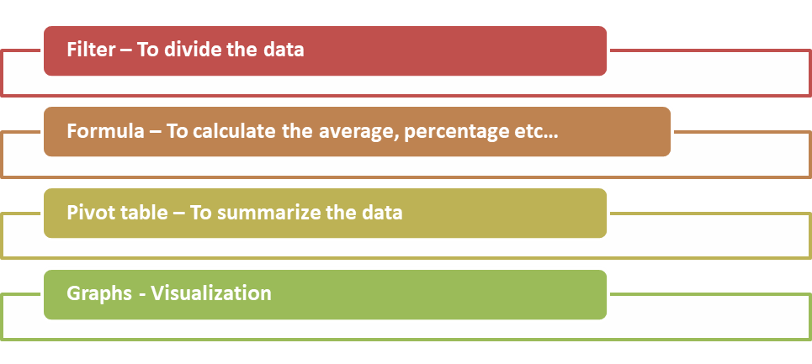
OUR SOLUTION AND ITS VALUE PROPOSITION
Techniques used for data analysis:
Our solution ensures fair and inclusive compensation across all demographics. It provides actionable insights for HR and leadership to make informed decisions. By offering competitive pay practices, we help boost employee satisfaction and retention. The analysis aligns salaries with performance and market trends, optimizing cost efficiency. Additionally, it addresses pay disparities and mitigates legal risks, ensuring compliance.

Slide 8
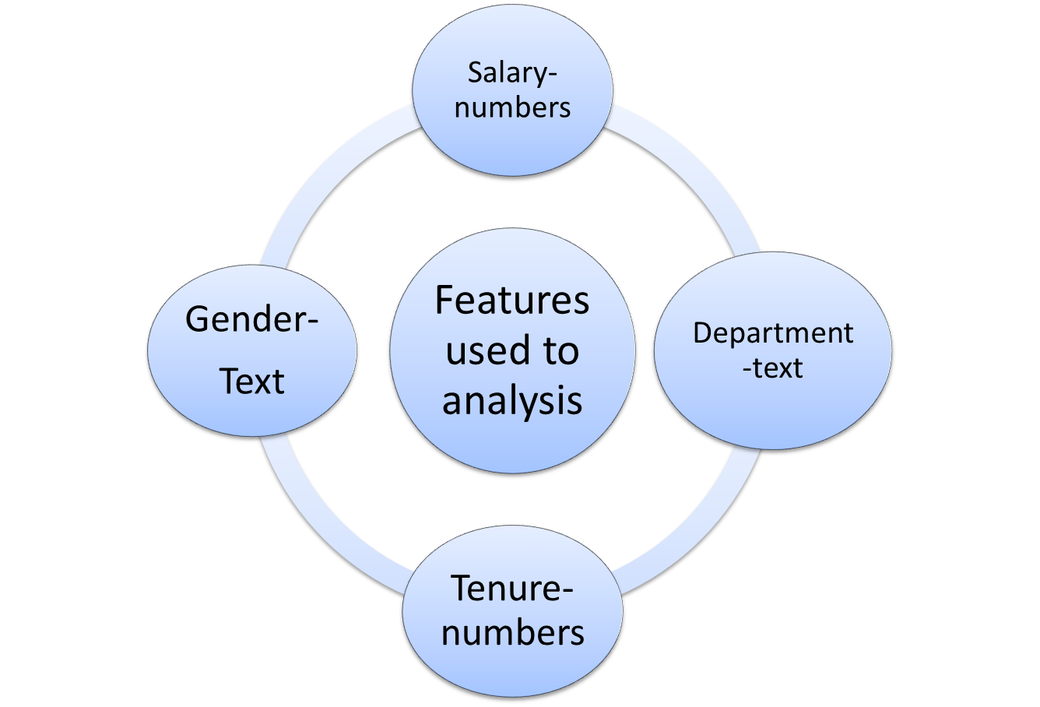

Dataset Description
Employee raw data set – Kaggle
Total features – 9 features
Filtered features – 4 features

Slide 9

THE "WOW" IN OUR SOLUTION
AI-Driven Insights: Predictive analytics for future salary trends and personalized pay recommendations.
Real-Time Visualization: Interactive dashboards for salary distribution and scenario analysis
.Fairness Metrics: Tools to ensure pay equity and industry benchmarking.
Employee Integration: Incorporating feedback and career path mapping
Automated Compliance: Automatic checks for legal compliance and tax optimization.
HR Integration: Seamless integration with other HR tools for a unified management system.
3/21/2024 Annual Review
9

Slide 10
MODELLING
Identify key performance indicators (KPIs) relevant to the role . Set specific, measurable, achievable, relevant, and time-bound (SMART) goals for each KPI.
Collect quantitative data such as sales numbers, completed projects, or customer ratings .
Gather qualitative data through feedback from supervisors, peers, and self-assessments.
Group employees with similar performance patterns through cluster analysis Assess effectiveness by evaluating the quality of work produce.Use regression analysis to find relationships between performance factors and outcomes.
10

Slide 11
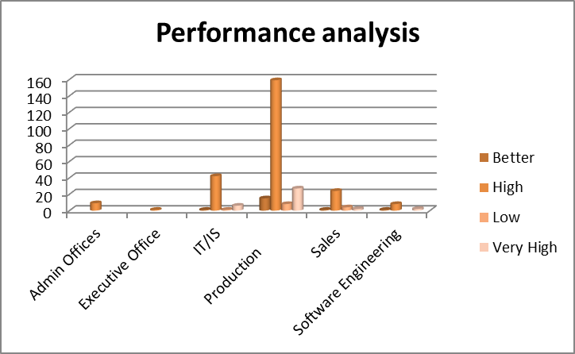
RESULTS
11

Slide 12
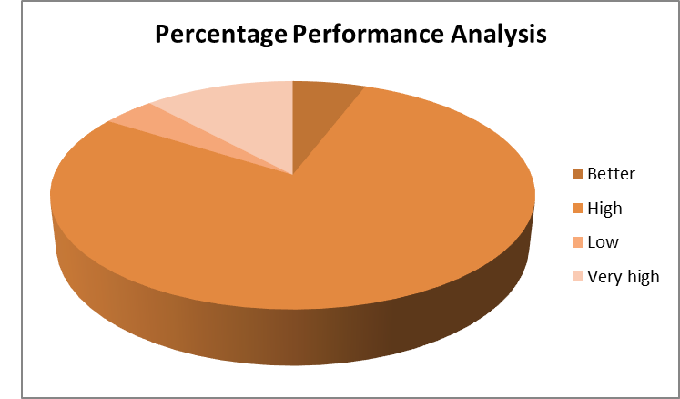
D

Slide 13
conclusion
The employee performance analysis reveals strengths in product management field and highlights opportunities for improvement in service and training field .
Key achievements include in accounting and marketing, which have positively impacted more production and increase in annual turnover .
Here the conclusion was made by me by using the excel
THANK YOU
THE END

